Slide 1
Spring Project
Spring MVC

Slide 2
Agenda
MVC Architecture
Spring MVC Architecture
---------------------------------
Create Maven project - web project
Configuration
Add Spring Dependencies in POM xml file
Configure web.xml
dispatcher-servlet.xml (Front Controller)
Create Login Page (Spring Form)
Create Controller (Project Specific )
One controller for each module

Slide 3
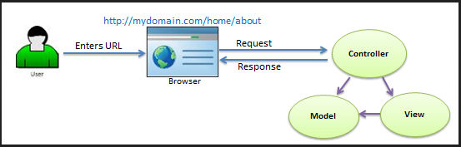
MVC Architecture

Slide 4
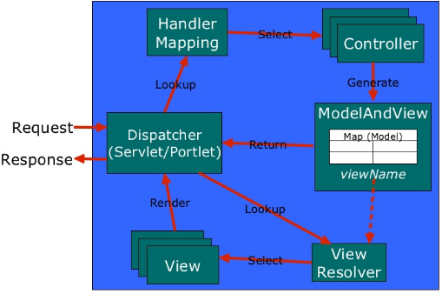
Spring MVC Architecture

Slide 5
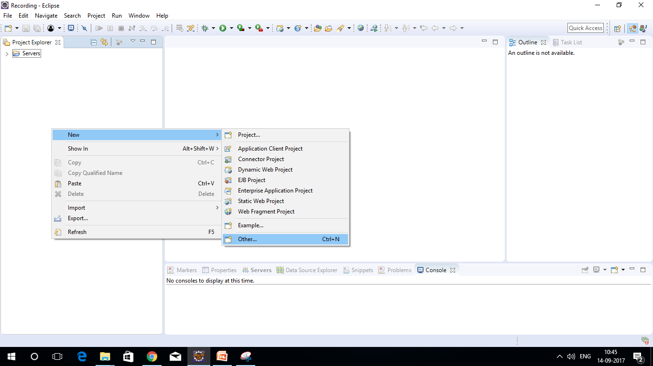
Creating New Maven project

Slide 6
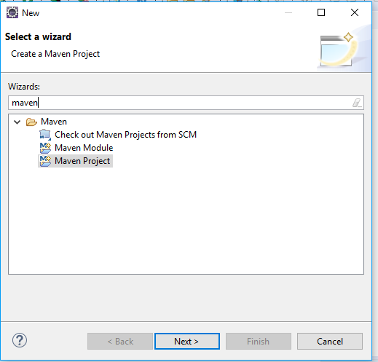
Creating New Maven project

Slide 7
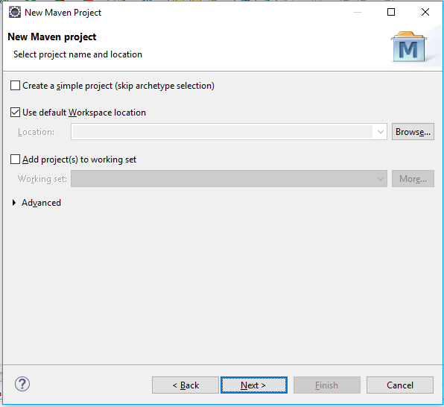
Creating New Maven project

Slide 8
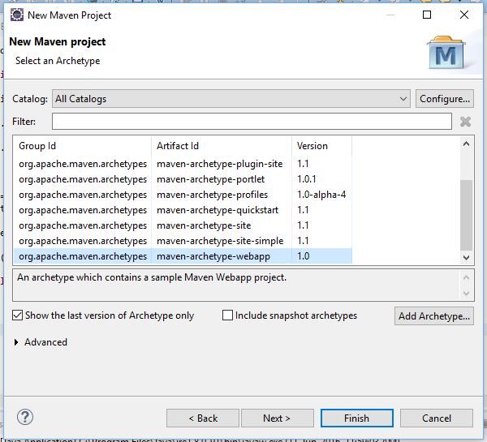
Create New Maven project

Slide 9
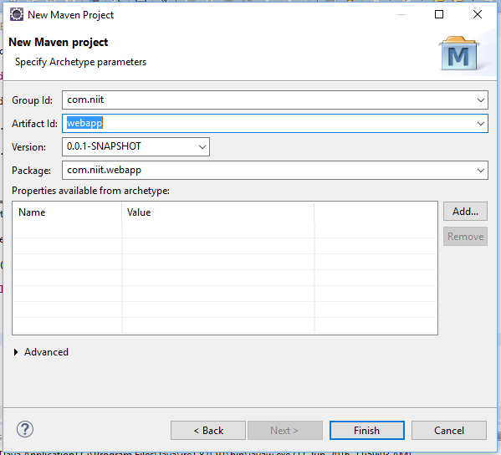
Provide Group ID and Artifact id

Slide 10
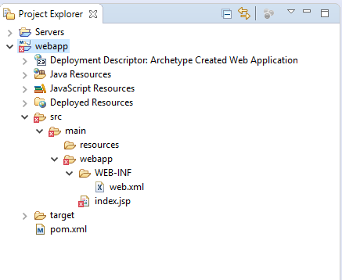
Project Structure

Slide 11
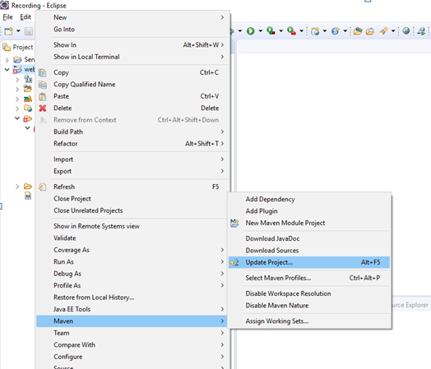
Folder structure not proper?

Slide 12
Error? "Could not resolve archetype org.apache.maven.archetypes:maven-archetype-webapp" "Failed to resolve version for org.apache.maven.archetypes:maven-archetype-webapp"
Open File>New Project>Open Maven > Archetypes
Click on 'Configure'
select 'Add Remote Catalog' and add the following:
Catalog File: http://repo1.maven.org/maven2/archetype-catalog.xml Description: maven catalog

Slide 13
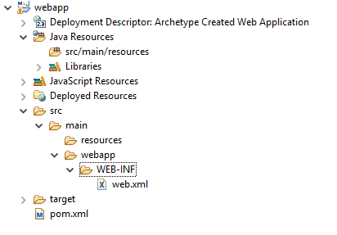
Delete index.jsp

Slide 14
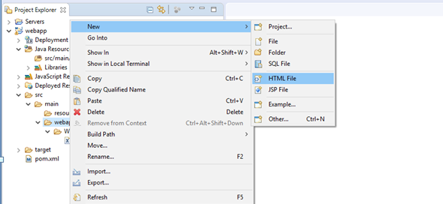
Create HTML File

Slide 15
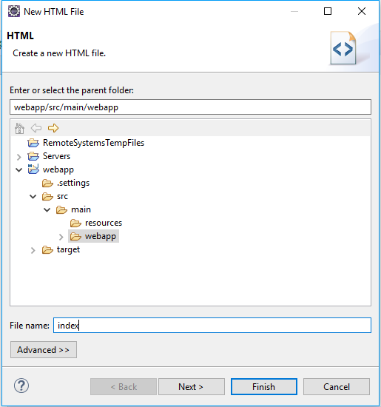
Create html page index.html

Slide 16
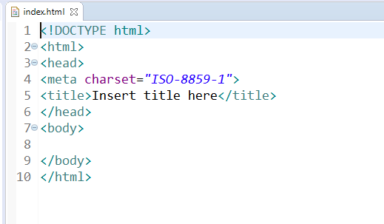
Generated HTML File

Slide 17
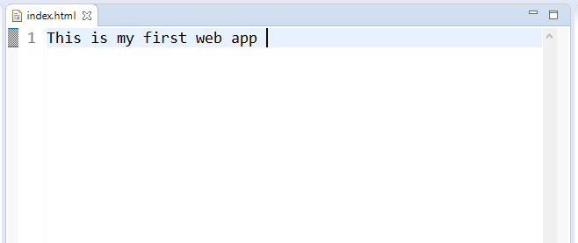
Index.html

Slide 18
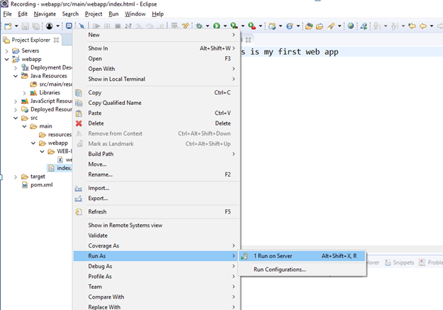
Run on Server

Slide 19
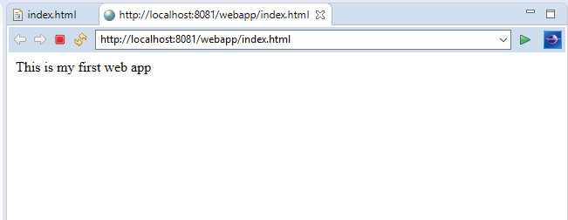

Slide 20
Is it Spring web app?
We have created simple web app

Slide 21
Is it Spring web app?
We have created simple web app
But it is not spring web app

Slide 22
Is it Spring web app?
We have created simple web app
But it is not spring web app
Need to add spring dependencies

Slide 23
Is it Spring web app?
We have created simple web app
But it is not spring web app
Need to add spring dependencies
Need to configure

Slide 24
Is it Spring web app?
We have created simple web app
But it is not spring web app
Need to add spring dependencies
Need to configure
Need to create controller
Etc.,

Slide 25
Add Spring web dependencies in pom.xml

Slide 26
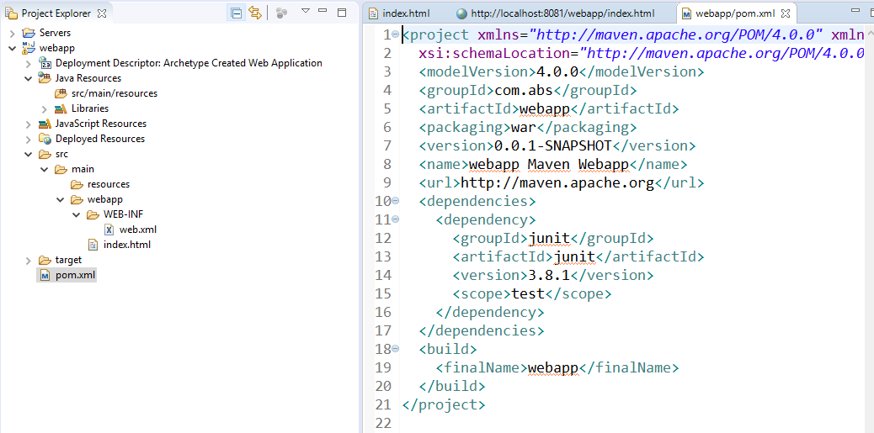
Generated pom.xml

Slide 27
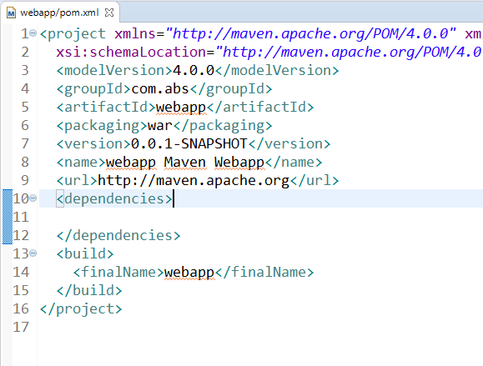
Delete unwanted dependencies

Slide 28
What we required for Spring web
Spring Core
Spring Web
Spring Web MVC

Slide 29
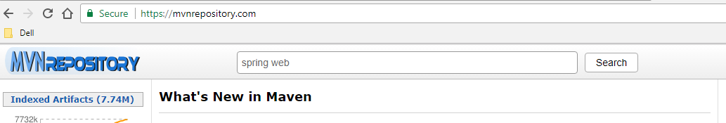
Where I can get dependencies?

Slide 30
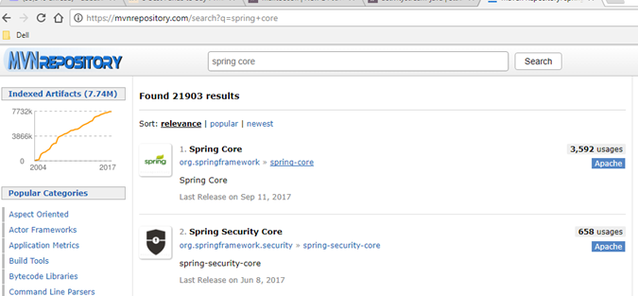

Slide 31
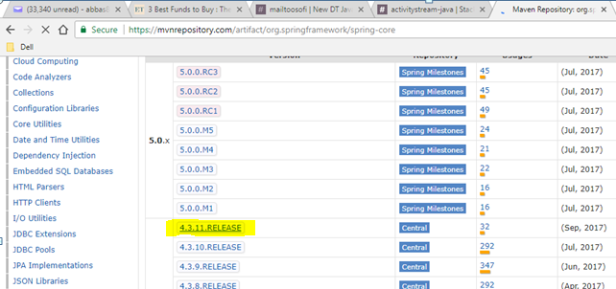

Slide 32
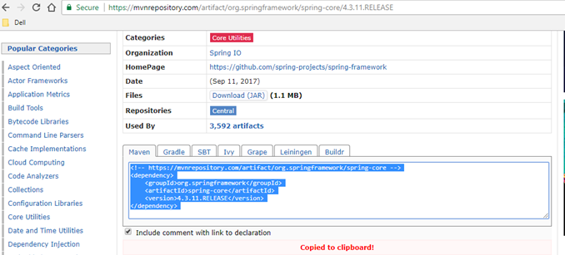

Slide 33
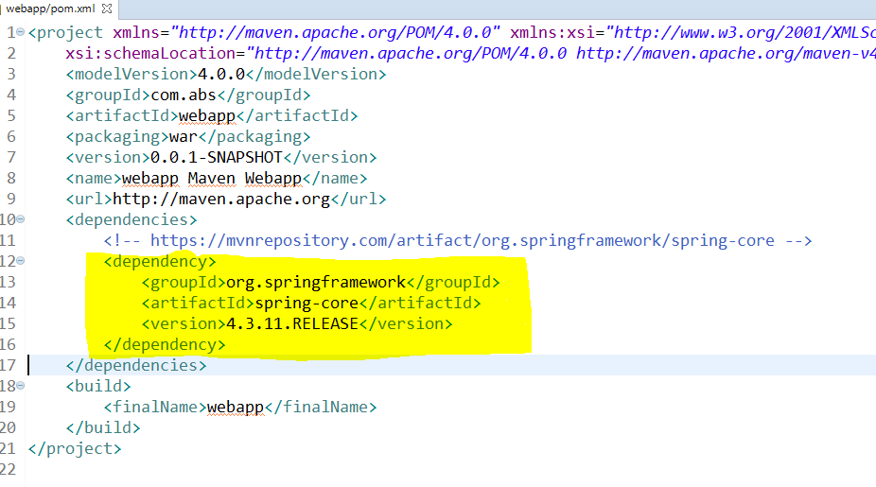

Slide 34
Repeat the same for other dependencies
Spring Core
Spring Web
Spring Web MVC

Slide 35
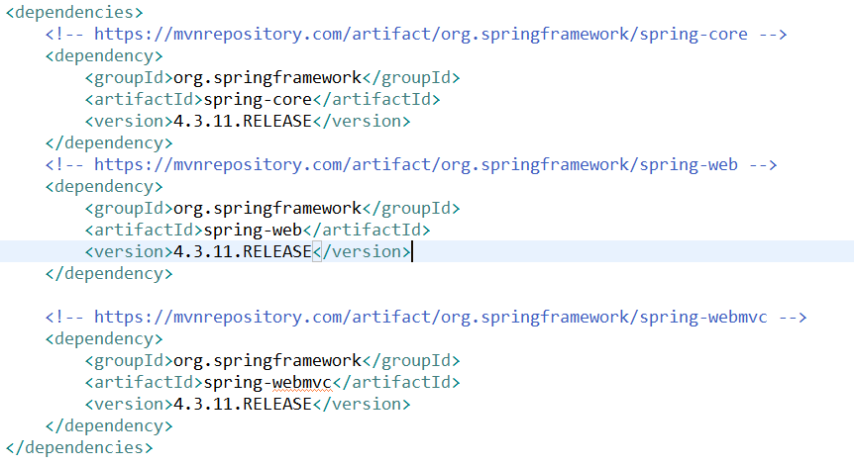
POM.xml

Slide 36
Configuration
XML Based Configuration
Web.xml
Dispatcher-servlet.xml
Java Based Configuration

Slide 37
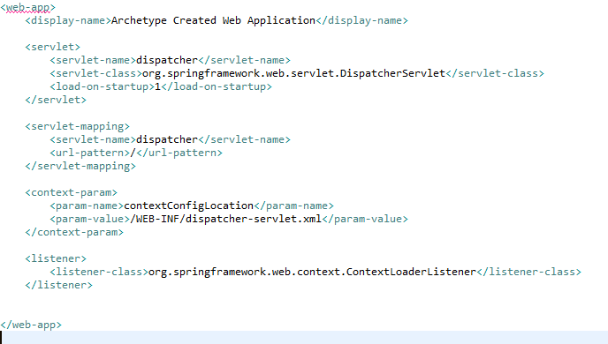
XML Based Configuration Web.xml

Slide 38
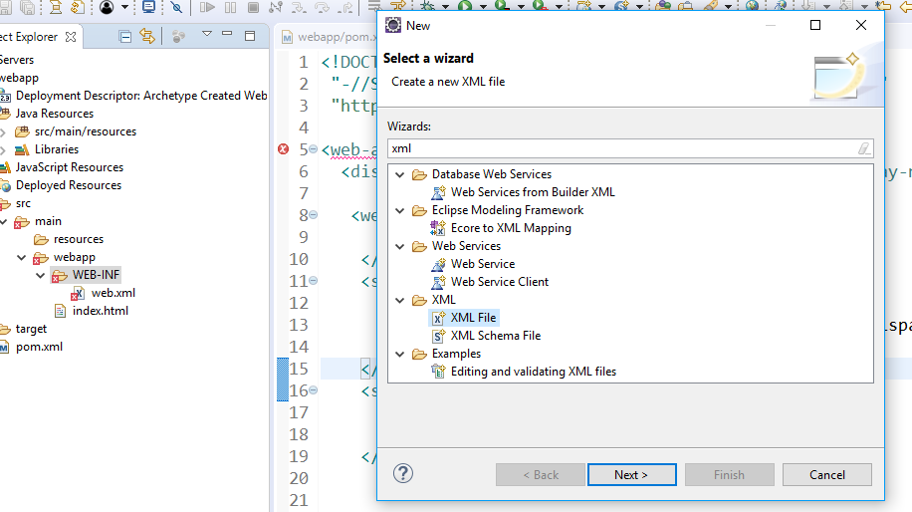
Create new xml file dispatcher-servlet.xml

Slide 39
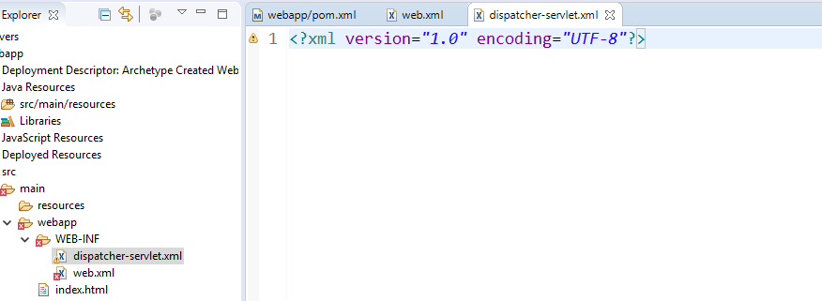

Slide 40
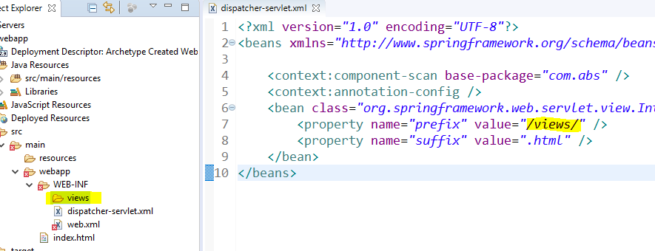

Slide 41
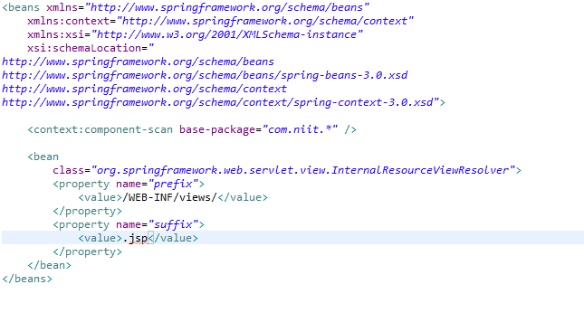
XML Based Configuration dispatcher-servlet.xml

Slide 42
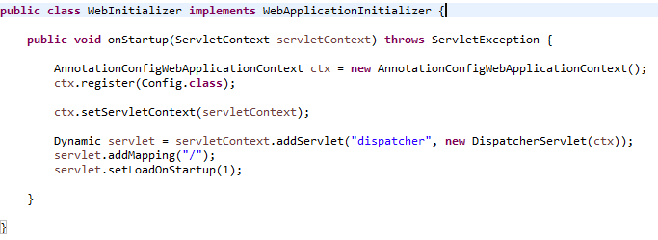
Java Based Configuration Web.xml(WebInitializer)
http://docs.spring.io/spring/docs/current/javadoc-api/org/springframework/web/WebApplicationInitializer.html

Slide 43
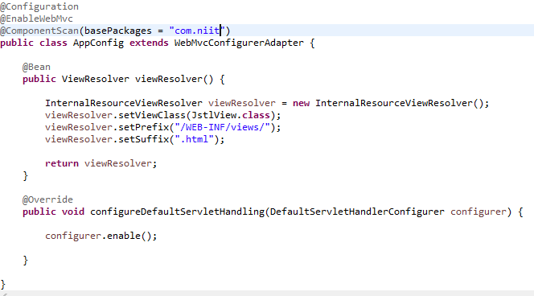
Java Based Configuration dispatcher-servlet.xml

Slide 44
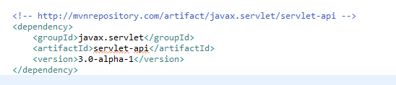
Getting Errors on pages?

Slide 45
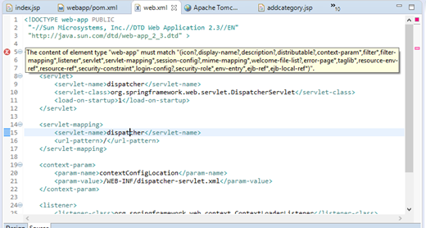
Error in web.xml?
Change the order

Slide 46
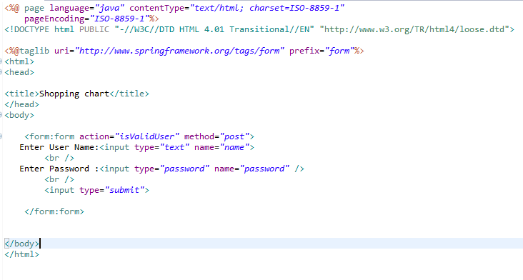
Login.jsp

Slide 47
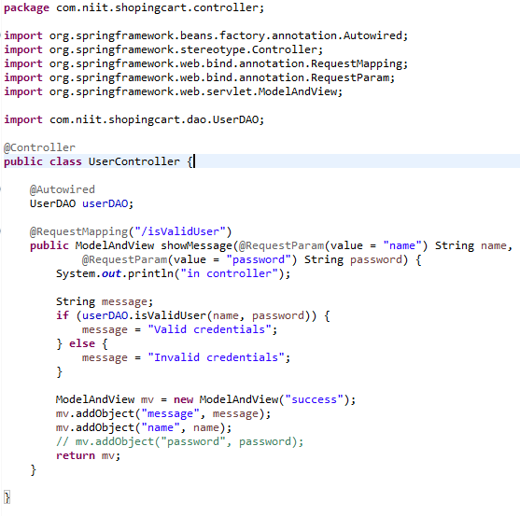
Create Controller

Slide 48
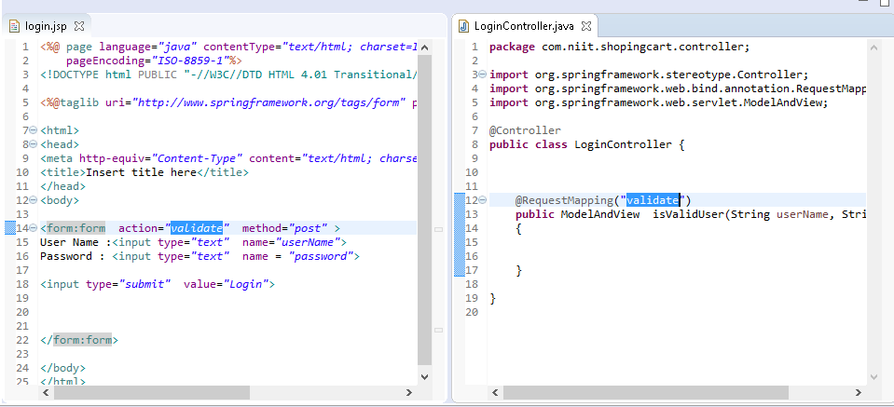

Slide 49
MVN Command
//Syntax
mvn archetype:generate
-DgroupId={project-packaging}
-DartifactId={project-name}
-DarchetypeArtifactId=maven-archetype-webapp
//for example
mvn archetype:generate
-DgroupId=com.niit
-DartifactId=ShoppingCart
-DarchetypeArtifactId=maven-archetype-webapp

